Slide 1
Summary:
PTM Attendance
PTM Feedbacks
PTM Mark Analysis
Interaction with TC applying parents
Overall report of Primary
Submitted by....
Mrs.Jeyarani S.

Slide 2
Viswam School CBSE
PTM Report - Prepared on 23-04-2024
Submitted by…..Mrs.Jeyarani S.
Co-Ordinator of Primary Sections

Slide 3
Primary Strength Details
Grade 1A 19
Grade 1B 23
Grade 1C 22
Grade 2A 28
Grade 2B 27
Grade 3A 23
Grade 3B 23
Grade 4A 24
Grade 4B 23
Grade 4C 24
Grade 5A 22
Grade 5B 23
Grade 5C 22
TOTAL 303

Slide 4
1. JEYA RANI S. Co-Ordinator
2. ANITHA Grade 1A
3. SHABREEN Grade 1B
4. NITHYA Grade 1C
5. LALITHA Grade 2A
6. RANI Grade 2B
7. SRI LATHA Grade 3A
8. SAIRA BANU Grade 3B
9. SHOBA Grade 4A
10. SIRISHA Grade 4B
11. REDDY BHAVANI Grade 4C
12. RUKVITHA Grade 5A
13. KUSUMA Grade 5B
14. KALAVATHI A. Grade 5C
15. SHARIKHA Computer
16. RUKSANA Hindi
18. KEYA SARKAR English
MOHANA English
Pavan P.E.T
Primary Teachers’ Name List

Slide 5
Primary PTM % Report
Grade 1A 79%
Grade 1B 92%
Grade 1C 91%
Grade 2A 100%
Grade 2B 100%
Grade 3A 96%
Grade 3B 78%
Grade 4A 83%
Grade 4B 86%
Grade 4C 96%
Grade 5A 72%
Grade 5B 92%
Grade 5C 86%
Overall Percentage 89%

Slide 6
PTM Attendance Chart-Primary
Total Strength = 303 100%
Present = 270 89%
Absent = 33 11%

Slide 7
Special congratulations
T.Lalitha - 2A 100% Attendance
K.Rani - 2B 100% Attendance

Slide 8
Grade 1A – Mark Analysis (Anitha)
Total Strength = 19
Toppers List ( Who got 100/100)
English Mohana | Telugu Shoba | Hindi Ruksana | Maths Anitha | EVS K.Rani | Comp. Sharika
5 | 10 | 5 | 11 | 12 | 9
Failure List ( Who got below 40)
English | Telugu | Hindi | Math | EVS | Comp
Nil | Nil | Nil | Nil | Nil | Nil

Slide 9
Grade 1B – Mark Analysis (Shabreen)
Total Strength = 23
Toppers List ( Who got 100/100)
English Shabreen | Telugu Shoba | Hindi Ruksana | Maths Srilatha | EVS K.Rani | Comp. Sharika
3 | 3 | 7 | 5 | 16 | 11
Failure List ( Who got below 40)
English | Telugu | Hindi | Math | EVS | Comp
Nil | Nil | Nil | Nil | Nil | Nil

Slide 10
Grade 1C – Mark Analysis (Nithya)
Total Strength = 22
Toppers List ( Who got 100/100)
English Keya | Telugu Lalitha | Hindi Ruksana | Maths Nithya | EVS K.Rani | Comp. Sharika
5 | 9 | 6 | 10 | 12 | 7
Failure List ( Who got below 40)
English | Telugu | Hindi | Maths | EVS | Comp
Nil | Nil | Nil | Nil | Nil | Nil

Slide 11
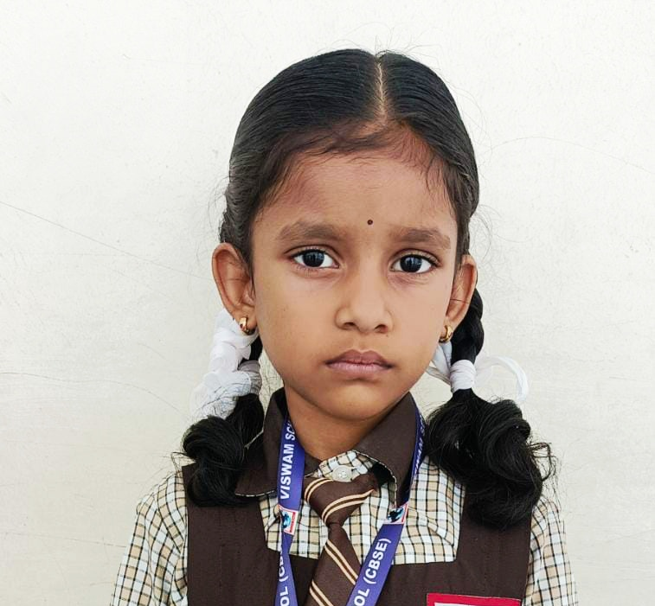
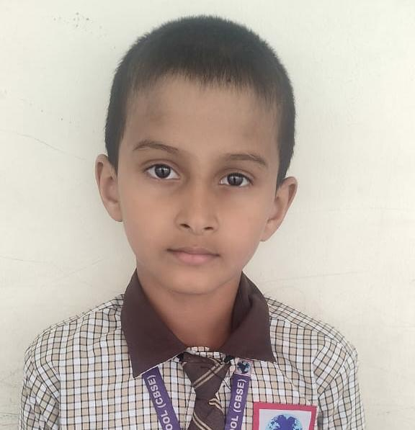
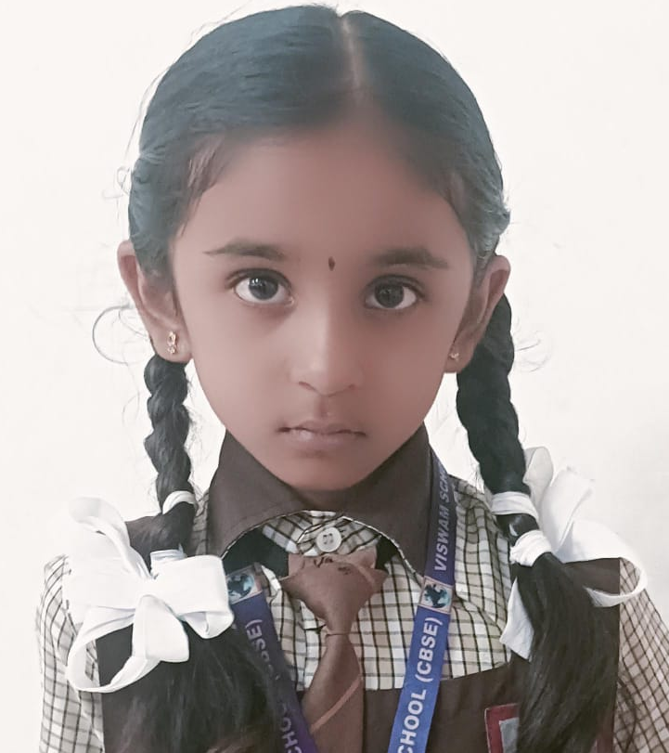
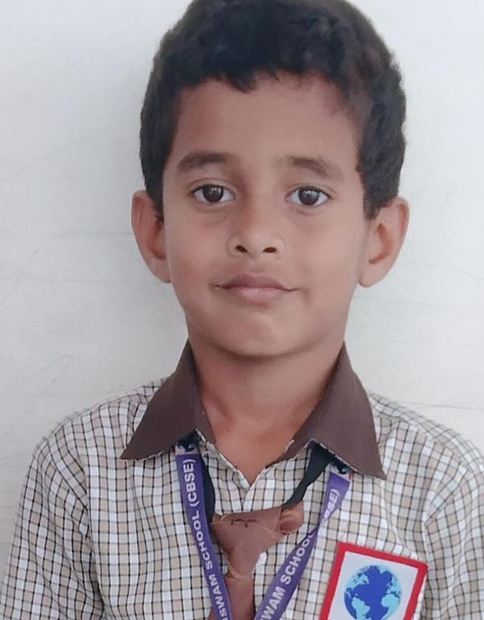
Rank Holder of Grade-I
Rank - I
T.Shanvikaa R.KaranTej T. Lasya Reddy
499/500 499/500 499/500
Rank -III
Rank - II
H. Srivaran S. Dhruvika Charvik Setty 497/500 497/500 497/500
R. Charish Reddy
498/500

Slide 12
Grade 2A – Mark Analysis (Lalitha)
Total Strength = 28
Toppers List ( Who got 100/100)
English Mohana | Telugu Lalitha | Hindi Saleema | Maths Anitha | EVS Srilatha | Comp. Sharika
8 | 9 | 1 | 0 | 9 | 5
Failure List ( Who got below 40)
English | Telugu | Hindi | Math | EVS | Comp
Nil | Nil | Nil | Nil | Nil | Nil

Slide 13
Grade 2B – Mark Analysis (K.Rani)
Total Strength = 27
Toppers List ( Who got 100/100)
English Keya | Telugu Lalitha | Hindi Saleema | Maths Nithya | EVS K.Rani | Comp. Rukvitha
13 | 9 | 5 | 5 | 17 | 5
Failure List ( Who got below 40)
English | Telugu | Hindi | Math | EVS | Comp
Nil | Nil | Nil | Nil | Nil | Nil

Slide 14
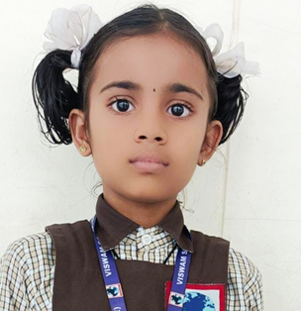
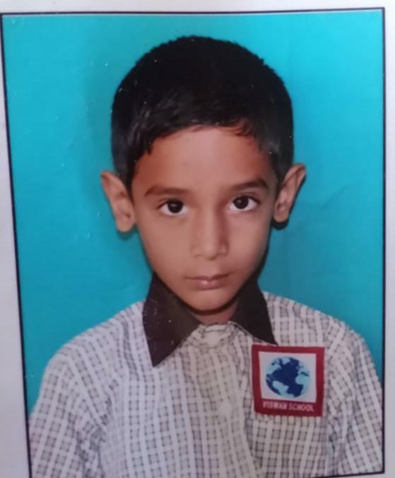
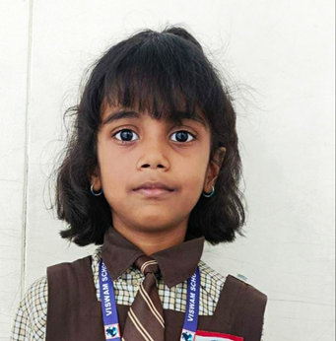
Rank Holder of Grade II
Rank - I
G.Sruthi
497/500
Rank - II
P.Tulasi Krishna R. Jithendra
495/500 495/500
Rank -III
M. Naga Chaithanya U. Chasvitha
494/500 494/500

Slide 15
Grade 3A – Mark Analysis (Saira)
Total Strength = 23
Toppers List ( Who got 100/100)
English Keya | Telugu Lalitha | Hindi R.Kala | Math Anitha | Sci Saira | Social Reshma
7 | 4 | 5 | 14 | 6 | 1
Comp Sharika
3
Failure List ( Who got below 40)
English | Telugu | Hindi | Math | Sci | Social
Nil | Nil | Nil | Nil | Nil | Nil
Comp
Nil

Slide 16
Grade 3B – Mark Analysis (Sreelatha)
Total Strength = 23
Toppers List ( Who got 100/100)
English Keya | Telugu Shoba | Hindi Saleema | Math Srilatha | Sci Saira | Social Reshma
8 | 5 | 3 | 8 | 3 | 4
Comp Sharika
4
Failure List ( Who got below 40)
English | Telugu | Hindi | Math | Sci | Social
Nil | Nil | Nil | Nil | Nil | Nil
Comp
Nil

Slide 17
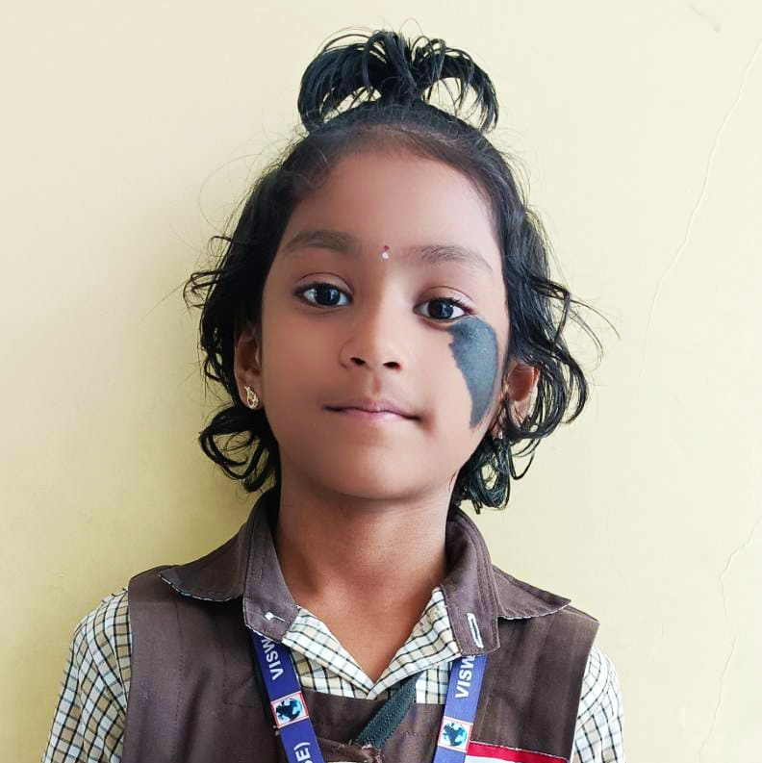
Rank Holder of Grade III
Rank - I
C. Mokshith M. Bhavya
599/600 599/600
Rank - II
K. Chirasvi R. Sarada
596/600 596/600
Rank -III
Y. Priscilla C. Jhogendar
595/600 595/600

Slide 18
Grade 4A – Mark Analysis (Shoba)
Total Strength = 24
Toppers List ( Who got 100/100)
English Kusuma | Telugu Shoba | Hindi Saleema | Maths Nithya | Sci Saira | Social Haneesha
3 | 1 | 2 | 1 | 3 | 1
Comp Sharika
4
Failure List ( Who got below 40)
English | Telugu | Hindi | Math | Sci | Social
Nil | Nil | Nil | Nil | Nil | Nil
Comp
Nil

Slide 19
Grade 4B – Mark Analysis (Sirisha)
Total Strength = 23
Toppers List ( Who got 100/100)
English Shabreen | Telugu Shoba | Hindi R.Kala | Maths Nithya | Sci Sirisha | Social Reshma
1 | 2 | 1 | 3 | 8 | 1
Comp Sharika
6
Failure List ( Who got below 40)
English | Telugu | Hindi | Math | Sci | Social
Nil | Nil | Nil | Nil | Nil | Nil
Comp
Nil

Slide 20
Grade 4C – Mark Analysis (Bhavani)
Total Strength = 24
Toppers List ( Who got 100/100)
English Kusuma | Telugu Lalitha | Hindi R.Kala | Maths Bhavani | Sci Sirisha | Social Reshma
7 | 3 | 5 | 4 | 8 | 3
Comp Sharika
2
Failure List ( Who got below 40)
English | Telugu | Hindi | Math | Sci | Social
Nil | Nil | Nil | Nil | Nil | Nil
Comp
Nil

Slide 21
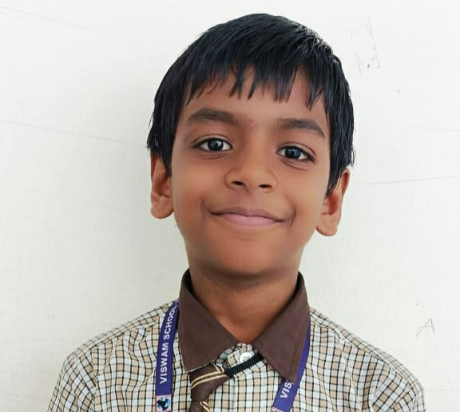
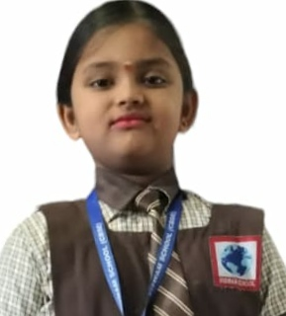
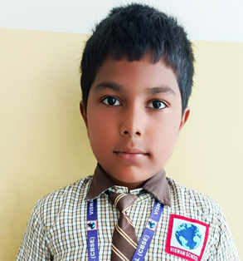
Rank Holder of Grade IV
Rank - I
P. Joshnika
600/600
Rank - II
K.Rishith A.Naga Shayan C.Thanu Sree
598/600 598/600 598/600
Rank -III
N. Manogna P. Abhyuday
595/600 595/600

Slide 22
Grade 5A – Mark Analysis (Rukvitha)
Total Strength = 22
Toppers List ( Who got 100/100)
English Nabeela | Telugu A.Kala | Hindi Saleema | Maths Anitha | Sci. Sirisha | Social Jeyarani
5 | 4 | 6 | 3 | 6 | 2
Comp Sharika
3
Failure List ( Who got below 40)
English | Telugu | Hindi | Math | Sci | Social
Nil | Nil | Nil | Nil | Nil | Nil
Comp
Nil

Slide 23
Grade 5B – Mark Analysis (Kusuma)
Total Strength = 23
Toppers List ( Who got 100/100)
English Kusuma | Telugu A.Kala | Hindi R.Kala | Maths Bhavani | Sci. Jayasree | Social Madhubala
10 | 4 | 7 | 4 | 6 | 4
Comp Sharika
5
Failure List ( Who got below 40)
English | Telugu | Hindi | Math | Sci | Social
Nil | Nil | Nil | Nil | Nil | Nil
Comp
Nil

Slide 24
Grade 5C – Mark Analysis (A.Kala)
Total Strength = 22
Toppers List ( Who got 100/100)
English Shabreen | Telugu A.Kala | Hindi R.Kala | Maths Bhavani | Sci. Saira | Social Jeyarani
4 | 5 | 5 | 1 | 5 | 3
Comp Sharika
2
Failure List ( Who got below 40)
English | Telugu | Hindi | Math | Sci | Social
Nil | Nil | Nil | Nil | Nil | Nil
Comp
Nil

Slide 25
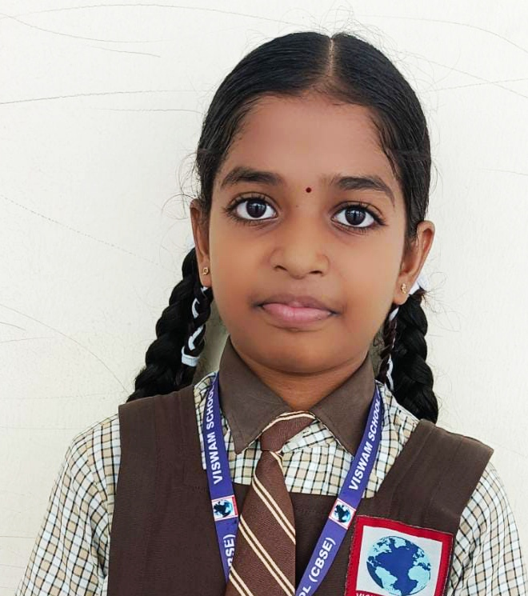
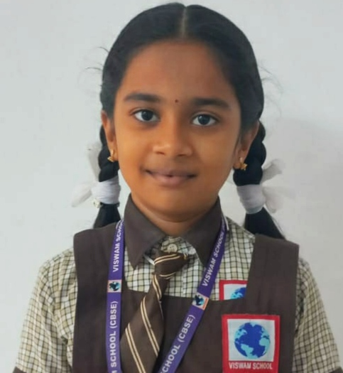
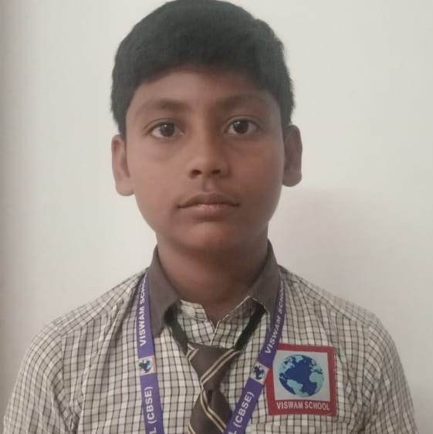
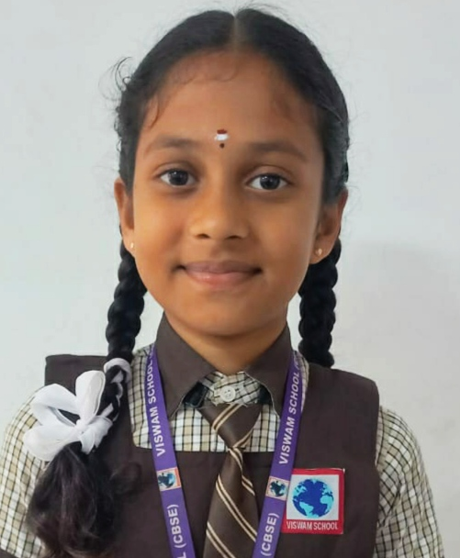
Rank Holder of Grade V
Rank - I
S. Upasana U. Chetana Sree K.Sushmitha N. Praveen
599/600 599/600 599/600 599/600
Rank - II
Y. Prem N. Bhanusree
598/600 598/600
Rank -III
S. Akila
597/600

Slide 26
Overall Failure in Primary
PA-3 PA-4 Term-2
Grade 1A Nil Nil Nil
Grade 1B Nil Nil Nil
Grade 1C Nil Nil Nil
Grade 2A 2 Nil Nil
Grade 2B Nil Nil Nil
Grade 3A 3 Nil Nil
Grade 3B 1 Nil Nil
Grade 4A Nil Nil Nil
Grade 4B 1 1 Nil
Grade 4C 4 1 Nil
Grade 5A 3 2 Nil
Grade 5B 1 Nil Nil
Grade 5C Nil Nil Nil
TOTAL 15 4 Nil

Slide 27
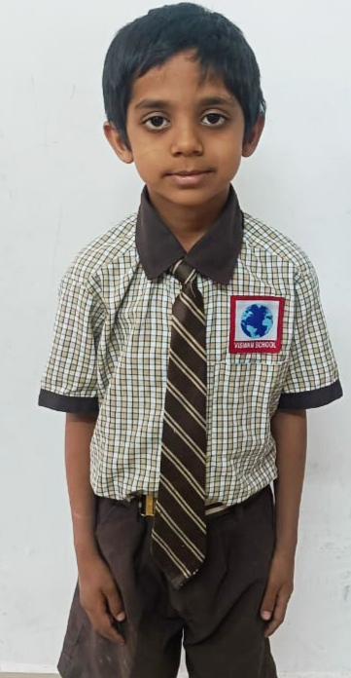
What I Want to be
Doctor ….63
Army ...63
Engineer … 27
Civil Service … 27
Police … 21
Player ….19
Teacher ….17
Scientist ….8
Artist ….3
Business …. 3
Singer ……2
Actor ….2
Dancer ….2
Pilot .…2
Astronaut ….1
Nurse ...1
CA ….1
Minister ….1
R. Charvik Reddy (IA)
He wants to be a Prime Minister
Mr.Narendra Modi
His Ambition:
To protect India from China & Pakistan

Slide 36
Overall Report from TODAY’s Meet
Grade 1 all are speaking in English. Parents are Happy
Need Improvement in English and Hindi in 2B (one Parent)
After the Exam …AnandaLahari is an Excellent idea.
100% Particiapation In Ananda Lahari is Very Good.
Need Separate Bus for School
Principal Has to arrange the parents meeting in the month of February to announce about the new policies and Developments Like EDOS
7. Happy about Cursive Handwriting

Slide 37
Suggestions: given in PA3
At the end of question paper in each Examination except Maths, we can give one para to write in cursive.
Implemented in Term-2 Examination
In all Languages, at the end of the QP given a statement to write in cursive. Grade 1 and 2 students enjoyed and written neatly.

Slide 38
Final PTM of Academic Year 2023-24

Slide 39
Funny Description About Teacher
The Lady of Sincerity
A Plate full
But
stomach Empty
A Sound Balloon
Need a smile in your face
Oral : Soundless
Written: Speechless
Rangoli Rani
Dancing Aspirant of English
Actually the Teacher Actually
AI of Primary
An Adaptable Teacher
Flying Butterfly Filled with Numbers
Reason Seeker -Y
A Silent Bomb
I Can do it
Parent Support - Teacher
Smiley Queen
LOGO Begum
Knowledge Seeker
Third Eye
Drill Master

Slide 40
Suggestions from Myside
Do not say “ I Can’t”
02. Do not the Beat the children of Primary

Slide 41
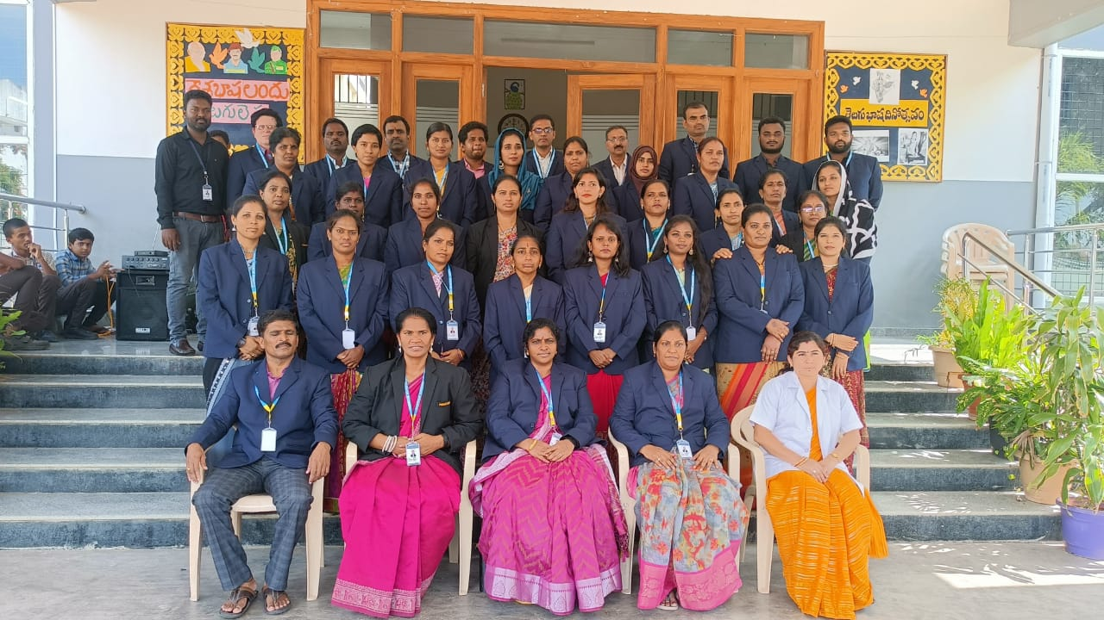
Thank You All

